Slide 1
Projection & View Volume

Slide 2
In Pipeline
3D Primitives
Modeling Transformation
Transform into 3D World Coordinate System
Lighting
Viewing Transformation
Projection Transformation
Clipping
Viewport Transformation
Scan Conversion
Image

Slide 3
In Pipeline
3D Primitives
Model Transformation
Transform into 3D World Coordinate System
Illustrate According to
Lighting and Reflectance
Lighting
Viewing Transformation
Projection Transformation
Clipping
Viewport Transformation
Scan Conversion
Image

Slide 4
In Pipeline
3D Primitives
Model Transformation
Transform into 3D World Coordinate System
Illustrate According to
Lighting and Reflectance
Lighting
Viewing Transformation
Transform into 3D Viewing Coordinate System
Projection Transformation
Clipping
Viewport Transformation
Scan Conversion
Image

Slide 5
In Pipeline
3D Primitives
Model Transformation
Transform into 3D World Coordinate System
Illustrate According to
Lighting and Reflectance
Lighting
Viewing Transformation
Transform into 3D Viewing Coordinate System
Projection Transformation
Transform into 2D Viewing Coordinate System
Clipping
Viewport Transformation
Scan Conversion
Image

Slide 6
In Pipeline
3D Primitives
Model Transformation
Transform into 3D World Coordinate System
Illustrate According to
Lighting and Reflectance
Lighting
Viewing Transformation
Transform into 3D Viewing Coordinate System
Projection Transformation
Transform into 2D Viewing Coordinate System
Clipping
Clip Primitives outside Window’s View
Viewport Transformation
Scan Conversion
Image

Slide 7
In Pipeline
3D Primitives
Model Transformation
Transform into 3D World Coordinate System
Illustrate According to
Lighting and Reflectance
Lighting
Viewing Transformation
Transform into 3D Viewing Coordinate System
Projection Transformation
Transform into 2D Viewing Coordinate System
Clipping
Clip Primitives outside Window’s View
Viewport Transformation
Transform into Viewport
Scan Conversion
Image

Slide 8
In Pipeline
3D Primitives
Model Transformation
Transform into 3D World Coordinate System
Illustrate According to
Lighting and Reflectance
Lighting
Viewing Transformation
Transform into 3D Viewing Coordinate System
Projection Transformation
Transform into 2D Viewing Coordinate System
Clipping
Clip Primitives outside Window’s View
Viewport Transformation
Transform into Viewport
Scan Conversion
Draw Pixels
Image

Slide 9
Transformation
3D Primitives
Model Transformation
Transform into 3D World Coordinate System
Illustrate According to
Lighting and Reflectance
Lighting
Viewing Transformation
Transform into 3D Viewing Coordinate System
Projection Transformation
Transform into 2D Viewing Coordinate System
Clipping
Clip Primitives outside Window’s View
Viewport Transformation
Transform into Viewport
Scan Conversion
Draw Pixels
Image

Slide 10
Transformation
P(x, y, z)
3D Object Coordinate
3D Viewing Coordinate
Model Transformation
3D World Coordinate
Viewing Transformation
3D Viewing Coordinate
Projection Transformation
3D Object Coordinate
2D Projection Coordinate
Viewport Transformation
3D World Coordinate
2D Device Coordinate
p(x’, y’) or p(u, v)

Slide 11
Viewing Transformation
P(x, y, z)
3D Object Coordinate
Model Transformation
3D World Coordinate
Viewing
Transformation
Viewing Transformation
3D Viewing Coordinate
Projection Transformation
2D Projection Coordinate
Viewport Transformation
2D Device Coordinate
p(x’, y’) or p(u, v)

Slide 12
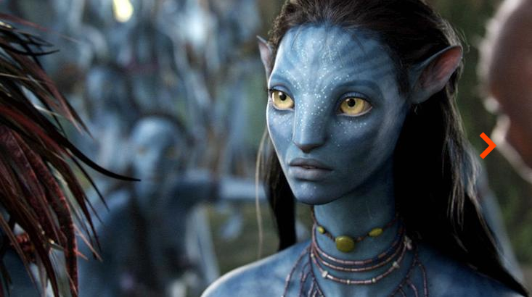
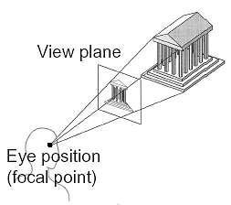
Camera Models
Real camera models
Lens distortion
Motion blur
Depth of field
Pin-hole camera
The most basic model
Without lens distortion
Without motion blur
Ideal projection case

Slide 13
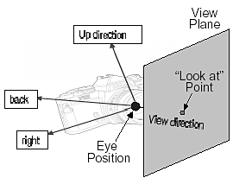
Viewing Parameters
Position
Eye position (px, py, pz)
Orientation
View direction (dx, dy, dz)
Up direction (ux, uy, uz)
Aperture
Field of view (xfov, yfov)
View plane
“look at” point
View-plane normal

Slide 14
Viewing Transformation
Mapping from world to viewing coordinates
Eye (camera) position moves to the origin
Up vector to Y axis
Right vector to X axis
Y
Camera
Z
X

Slide 15
Viewing Coordinate
Canonical coordinate system
Convention is right-handed (looking down –z axis)
Convention for projection, clipping, etc.
Viewing up vector maps to Y axis
Y
X
Viewing right vector maps to X axis
Viewing back vector maps to Z axis
Z

Slide 16
Transformation from WC to VC
Transformation sequences
Translate the view reference point to the origin of WC
Apply rotations
To align the x_{v}, y_{v}, and z_{v} axes with the world axes
y_{w}
y_{v}
x_{v}
y_{w}
y_{w}
z_{v}
y_{v}
x_{v}
y_{v}
z_{v}
x_{w}
x_{w}
z_{v}
x_{v}
x_{w}
z_{w}
z_{w}
z_{w}
General Sequence of Translate-rotate Transformation

Slide 17
Transformation from WC to VC (cont’)
Translation
View reference point (x₀, y₀, z₀)
Rotation
Rotate about the x_{w} to bring z_{v} into the x_{w}z_{w} plane
Rotate about the y_{w} to align the z_{w} and z_{v}
Rotate about the z_{w} to align the y_{w} and y_{v}

Slide 18
Transformation from WC to VC (cont’)
Rotation by uvn system
Calculate unit uvn vectors
N: view-plane normal vector
V: view-up vector
U: perpendicular to both N and V
Form the composite rotation matrix

Slide 19
Viewing Transformation
P(x, y, z)
3D Object Coordinate
Model Transformation
3D World Coordinate
Viewing Transformation
3D Viewing Coordinate
Projection
Transformation
Projection Transformation
2D Projection Coordinate
Viewport Transformation
2D Device Coordinate
p(x’, y’) or p(u, v)

Slide 20
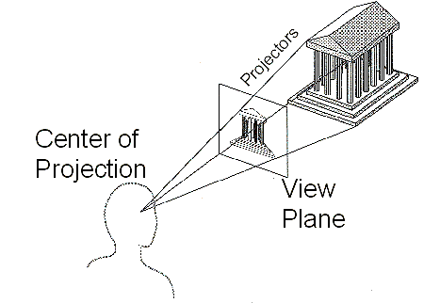
Projection
General definition
Transform points in n-space to m-space (m<n)
In computer graphics
Map viewing coordinates to 2D screen coordinates

Slide 21
Taxonomy of Projections
Planar geometric projection
Parallel
Perspective
Orthographic
Oblique
One-point
Three-point
Two-point
Top
Axonometric
Cabinet
Other
Front
Cavalier
Side

Slide 22
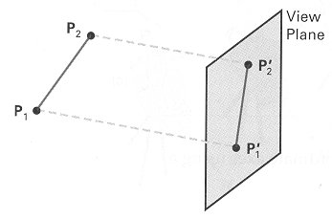
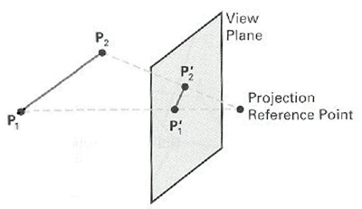
Parallel & Perspective
Parallel Projection
Perspective Projection

Slide 23
Taxonomy of Projections
Planar geometric projection
Parallel
Perspective
Orthographic
Oblique
One-point
Three-point
Two-point
Top
Axonometric
Cabinet
Other
Front
Cavalier
Side

Slide 24
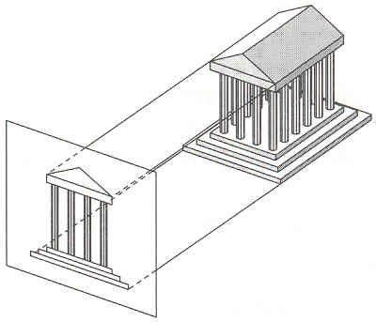
Parallel Projection
Center of projection is at infinity
Direction of projection (DOP)
Same for all points
DOP
View Plane

Slide 25
Taxonomy of Projections
Planar geometric projection
Parallel
Perspective
Orthographic
Oblique
One-point
Three-point
Two-point
Top
Axonometric
Cabinet
Other
Front
Cavalier
Side

Slide 26
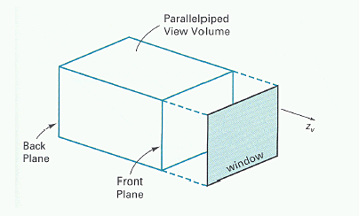
Parallel Projection View Volume

Slide 27
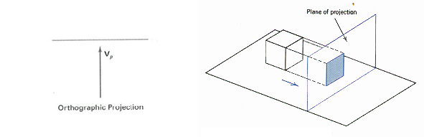
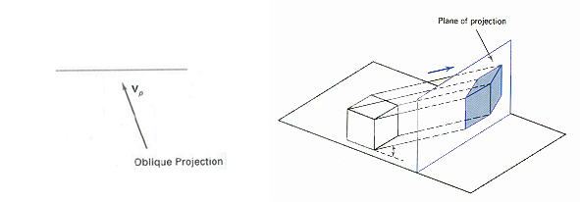
Orthographic & Oblique
Orthographic projection
Perpendicular to the view plane
Oblique projection
Inclined with respect to the view plane

Slide 28
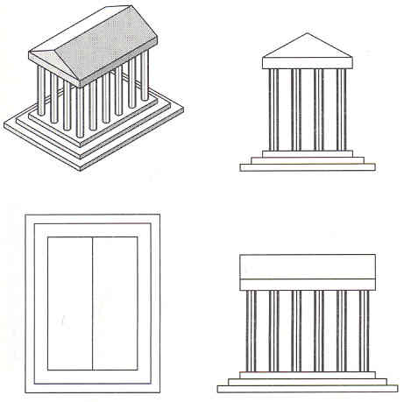
Orthographic Projections
DOP perpendicular to view plane
Front
Top
Side

Slide 29
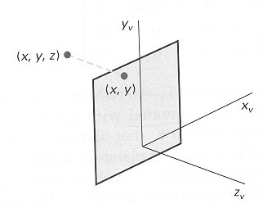
Orthographic Coordinates

Slide 30
Oblique Projections
DOP not perpendicular to view plane
Specified with two angles
α (DOP)
φ
Cavalier
(DOP at 45 )
Cabinet
(DOP at 63.4 )

Slide 31
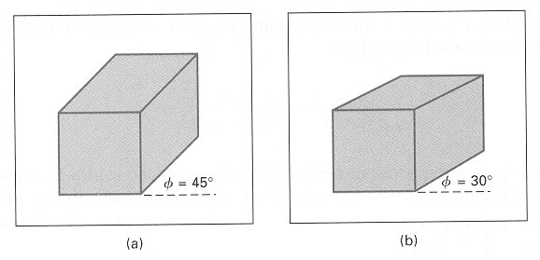
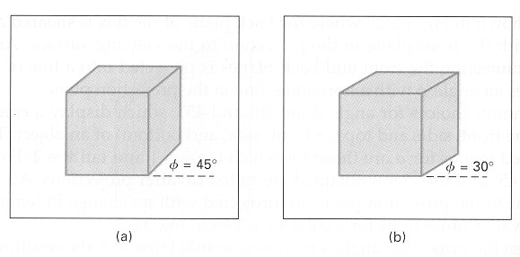
Oblique Projections
DOP not perpendicular to view plane
Cavalier projection
Cabinet projection

Slide 32
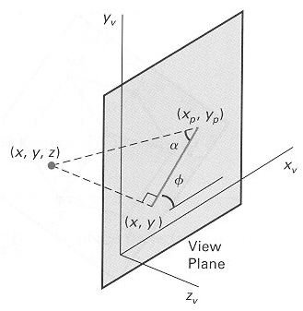
Parallel Projection Matrix
General parallel projection transformation

Slide 33
Taxonomy of Projections
Planar geometric projection
Parallel
Perspective
Orthographic
Oblique
One-point
Three-point
Two-point
Top
Axonometric
Cabinet
Other
Front
Cavalier
Side

Slide 34
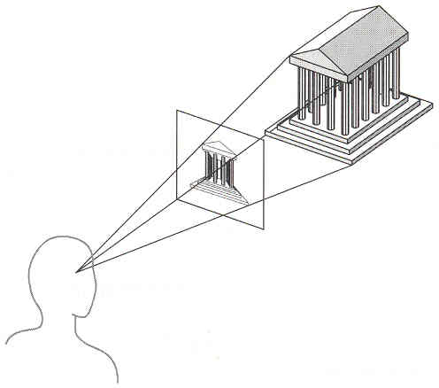
Perspective Projection
Map points
Onto “view plane”
Along “projectors”
Emanating from “center of projection” (COP)
Projectors
Center of Projection
View Plane

Slide 35
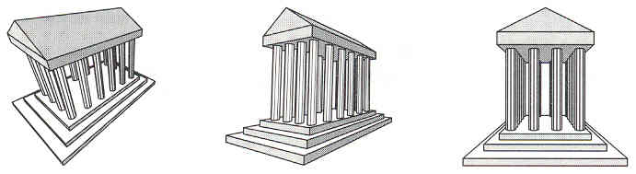
Perspective Projection
How many vanishing points?

Slide 36
Perspective Projection
How many vanishing points?
Three-point Perspective

Slide 37
Perspective Projection
How many vanishing points?
Three-point Perspective
Two-point Perspective

Slide 38
Perspective Projection
How many vanishing points?
Three-point Perspective
Two-point Perspective
One-point Perspective

Slide 39
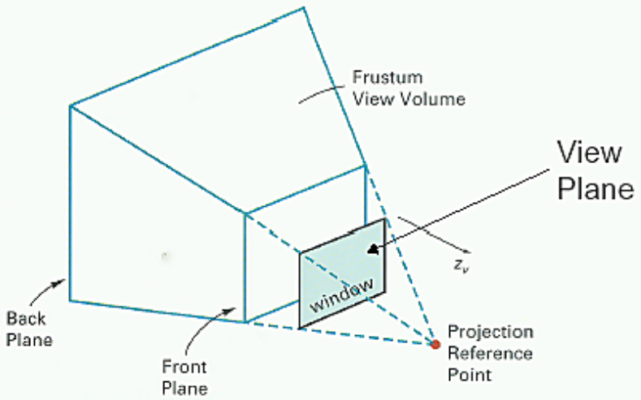
Perspective Projection View Volume

Slide 40
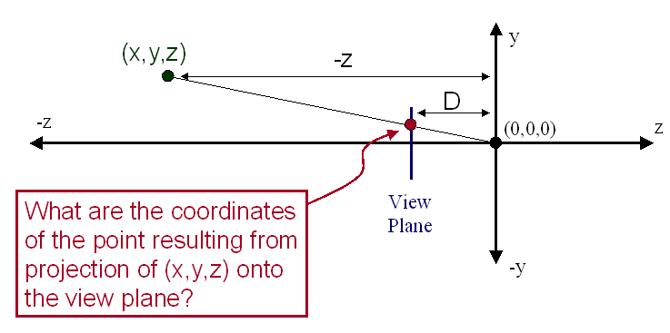
Perspective Projection
Compute 2D coordinates
From 3D coordinates with similar triangles

Slide 41
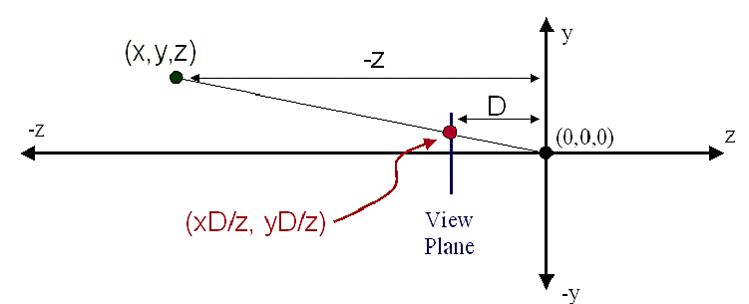
Perspective Projection
Compute 2D coordinates
From 3D coordinates with similar triangles

Slide 42
Perspective Projection Matrix
4x4 matrix representation?

Slide 43
Perspective Projection Matrix
4x4 matrix representation?

Slide 44
Perspective vs. Parallel
Perspective projection
+ Size varies inversely with distance
– Looks realistic
– Distance and angles are not (in general) preserved
– Parallel lines do not (in general) remain parallel
Parallel projection
+ Good for exact measurements
+ Parallel lines remain parallel
– Angles are not (in general) preserved
– Less realistic looking

Slide 45
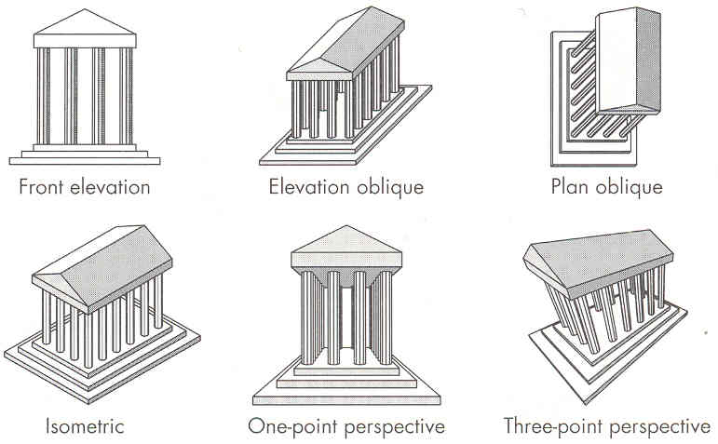
Classical Viewing

Slide 46
OpenGL Viewing & Volume
void gluLookAt
GLdouble eyex, GLdouble eyey, GLdouble eyez, GLdouble atx, GLdouble aty, GLdouble atz, GLdouble upx, GLdouble upy, GLdouble upz
eyex, eyey, eyez : Camera Position(x,y,z)
atx, aty, atz : Camera Focus(x,y,z)
upx, upy, upz : Camera Upvector(gradient)
Default
gluLookAt(0.0, 0.0, 0.0, 0.0, 0.0, -100.0, 0.0, 1.0, 0.0);

Slide 47
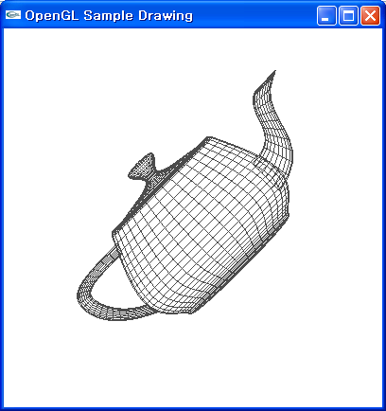
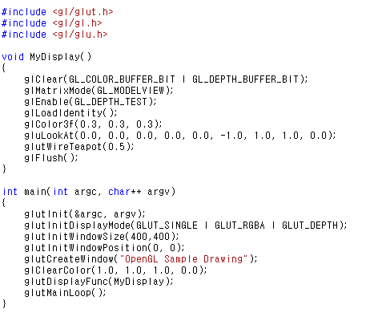
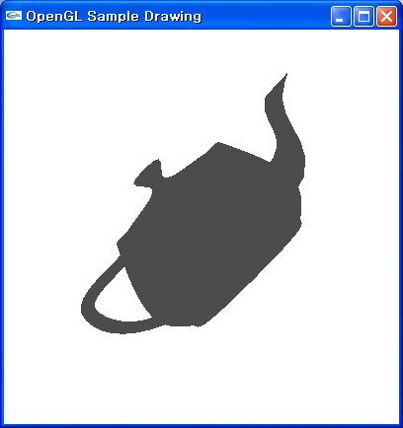
OpenGL Viewing & Volume
void gluLookAt

Slide 48
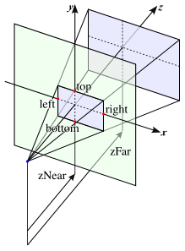
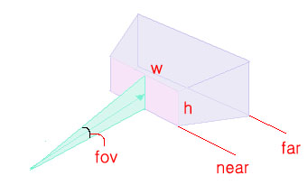
OpenGL Viewing & Volume
void glOrtho
GLdouble left, GLdouble right, GLdouble bottom, GLdouble top
GLdouble zNear, GLdouble zFar
void glFrustum
GLdouble left, GLdouble right, GLdouble bottom, GLdouble top
GLdouble zNear, GLdouble zFar
void glPerspective
GLdouble fov, GLdouble aspect, GLdouble near, GLdouble fars
fov : Field of View(degree : 0 ~ 180)
aspect : Aspect Ratio(Width/Height)
near : near clipping plane
far : far clipping plane

Slide 49
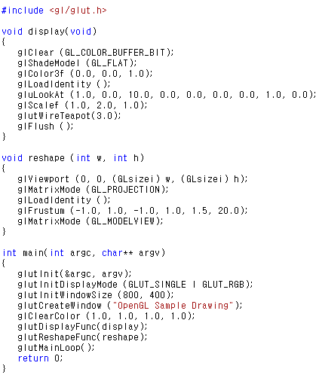
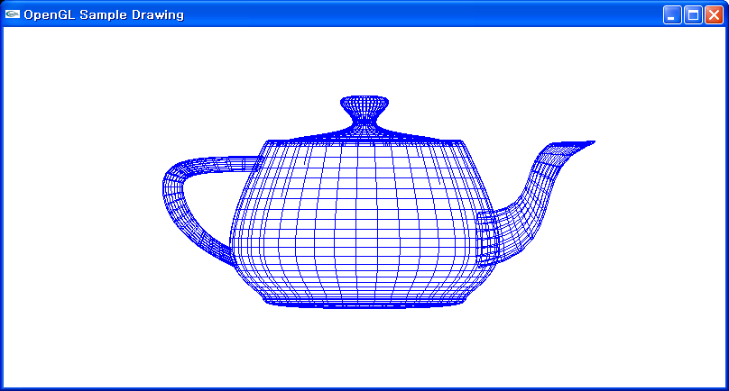
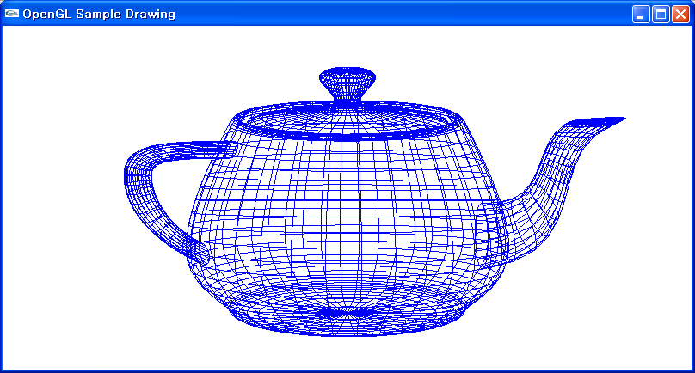
OpenGL Viewing & Volume
void glFrustum

